Slide 1
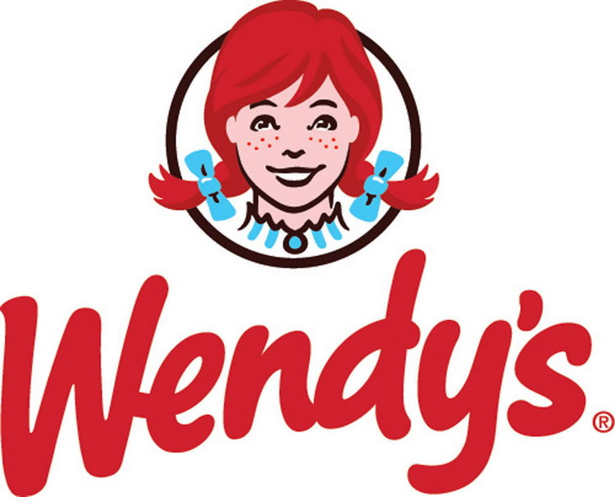
Do what tastes right !
Group 7:
Aarohi Tripathi
Yu-Ti Shih
Mengju, Lulu, Lu
Nirav Patel
Rita Metzinger

Slide 2
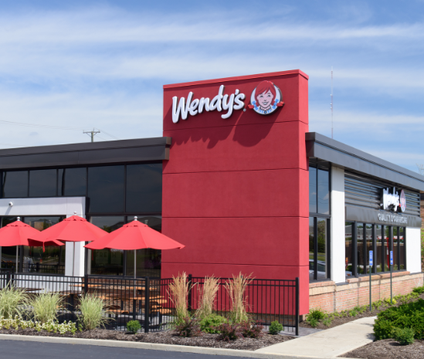
Agenda
Executive Summary
Analytics Strategy
Market Segmentation
Actionable Insights

Slide 3
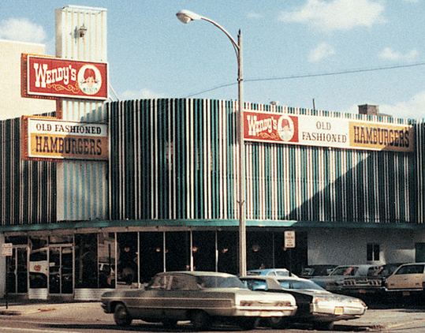
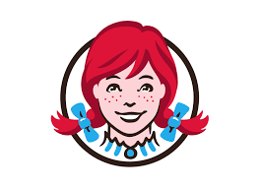
Executive Summary
About Wendy’s:
Quick service restaurant established in 1969 by Dave Thomas in Columbus, Ohio
Headquarters – Dublin Ohio
126,537 Total Restaurants Internally as of July 2018
5,739 in the United States
NASDAQ | WEN $17.66
Business Objectives:
Maximize revenue based on segmentation, product bundling and pricing structures.
Increase loyalty base and profit margins by optimizing marketing communication and promotions.
Financial Impact:
If our proposed methodology is applied to all U.S. based Wendy’s locations, we project an increased total revenue of $40,482,561.66 !!!

Slide 4
Analytics Strategy
Segmentation
Ordinary Least Square
Market Basket Analysis and Marcom
Cluster Analysis
Bundle most relevant products to increase sales & revenue
Price Sensitivity Analysis
Determine which cluster is price sensitive/insensitive.
How would price increase or decreases impact revenue
Identify Product Purchase Patterns
Analyze What Percent of the Total Population Each Cluster Represents.
Determine What Percent of the Total Revenue Each Cluster Represents.
Significant Variables for segmentation
Determine what relationships exist within the datasets to understand customer behavior.
Determine which products to refrain from bundling together for specific segments
To find the best strategy for communication

Slide 5
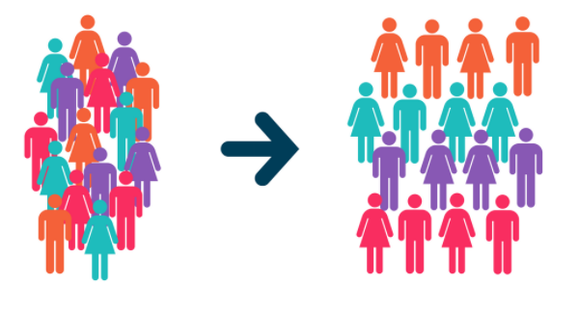
Segmentation
Segment 1 : Frosty Fans
Segment 2 : Health Nuts
Segment 3 : Hamburgers or Bust!
Segment 4 : Soccer Parents
Notes:
Unofficially voted most likely to riot should the supply of hamburgers ever run out.

Slide 6
Segmentation
Notes:
Add in graphs for:
Share of Total Revenue
Profit Margin
Average Total Sales Value
% Customer Share compared to % revenue share

Slide 7
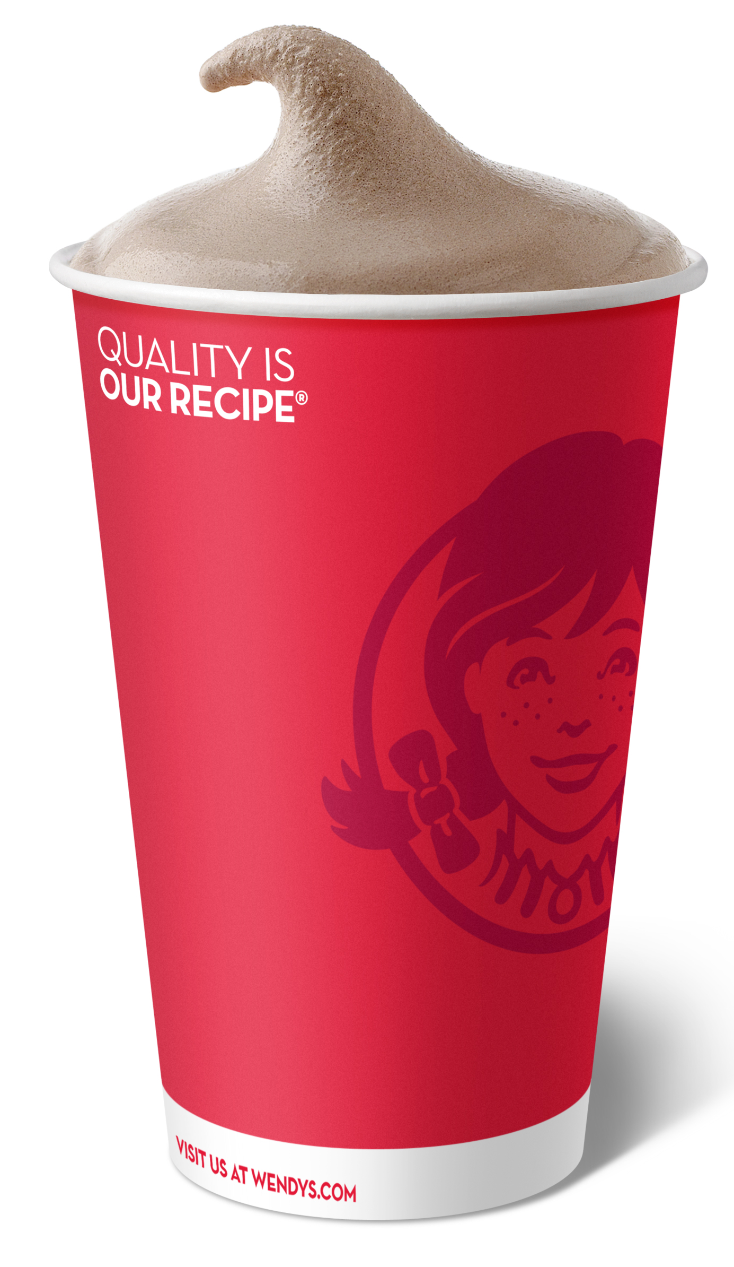
Segment 1 - Frosty Fans
General Outlook
Segment Size (28.66%)
Highest Household Income
Revenue Share (13.78%)
Mostly purchase frostys
Most users for redeeming the welcome reward points
Marcom and Elasticity
Increase the communication through SMS and email
Decrease direct mails to the consumers in this segment
Inelastic (0.0939)

Slide 8
Segment 1 - Frosty Fans
Suggestions
Bundle deals as :
i) Frosty + Bakery
ii) Bakery + Chicken
iii) Frosty + Bakery + Chicken
iv) Fries + Beverage + Value Meal
Marketing Recommendations
Send coupons for the bundles
Extra rewards for Frostys to engage them more into reward program

Slide 9
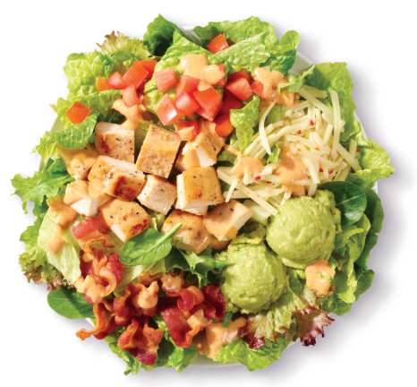
Segment 2 - Health Nuts
General Outlook
Largest segment (31.22%)
Revenue Share (13.55%)
Mostly purchase Salad
Highest consumption during Breakfast, Afternoon and Night
Marcom and Elasticity
Increase the communication through Direct mail and SMS
Decrease Email to the consumers in this segment
Inelastic (0.0608)

Slide 10
Segment 2 - Health Nuts
Suggestions
Bundle deals as :
i) Salad + Bakery
ii) Salad + Bakery + Chicken
Marketing Recommendations
Send coupons for the bundles
Giving them options to customize Salads
More frequent reward points to attract them

Slide 11
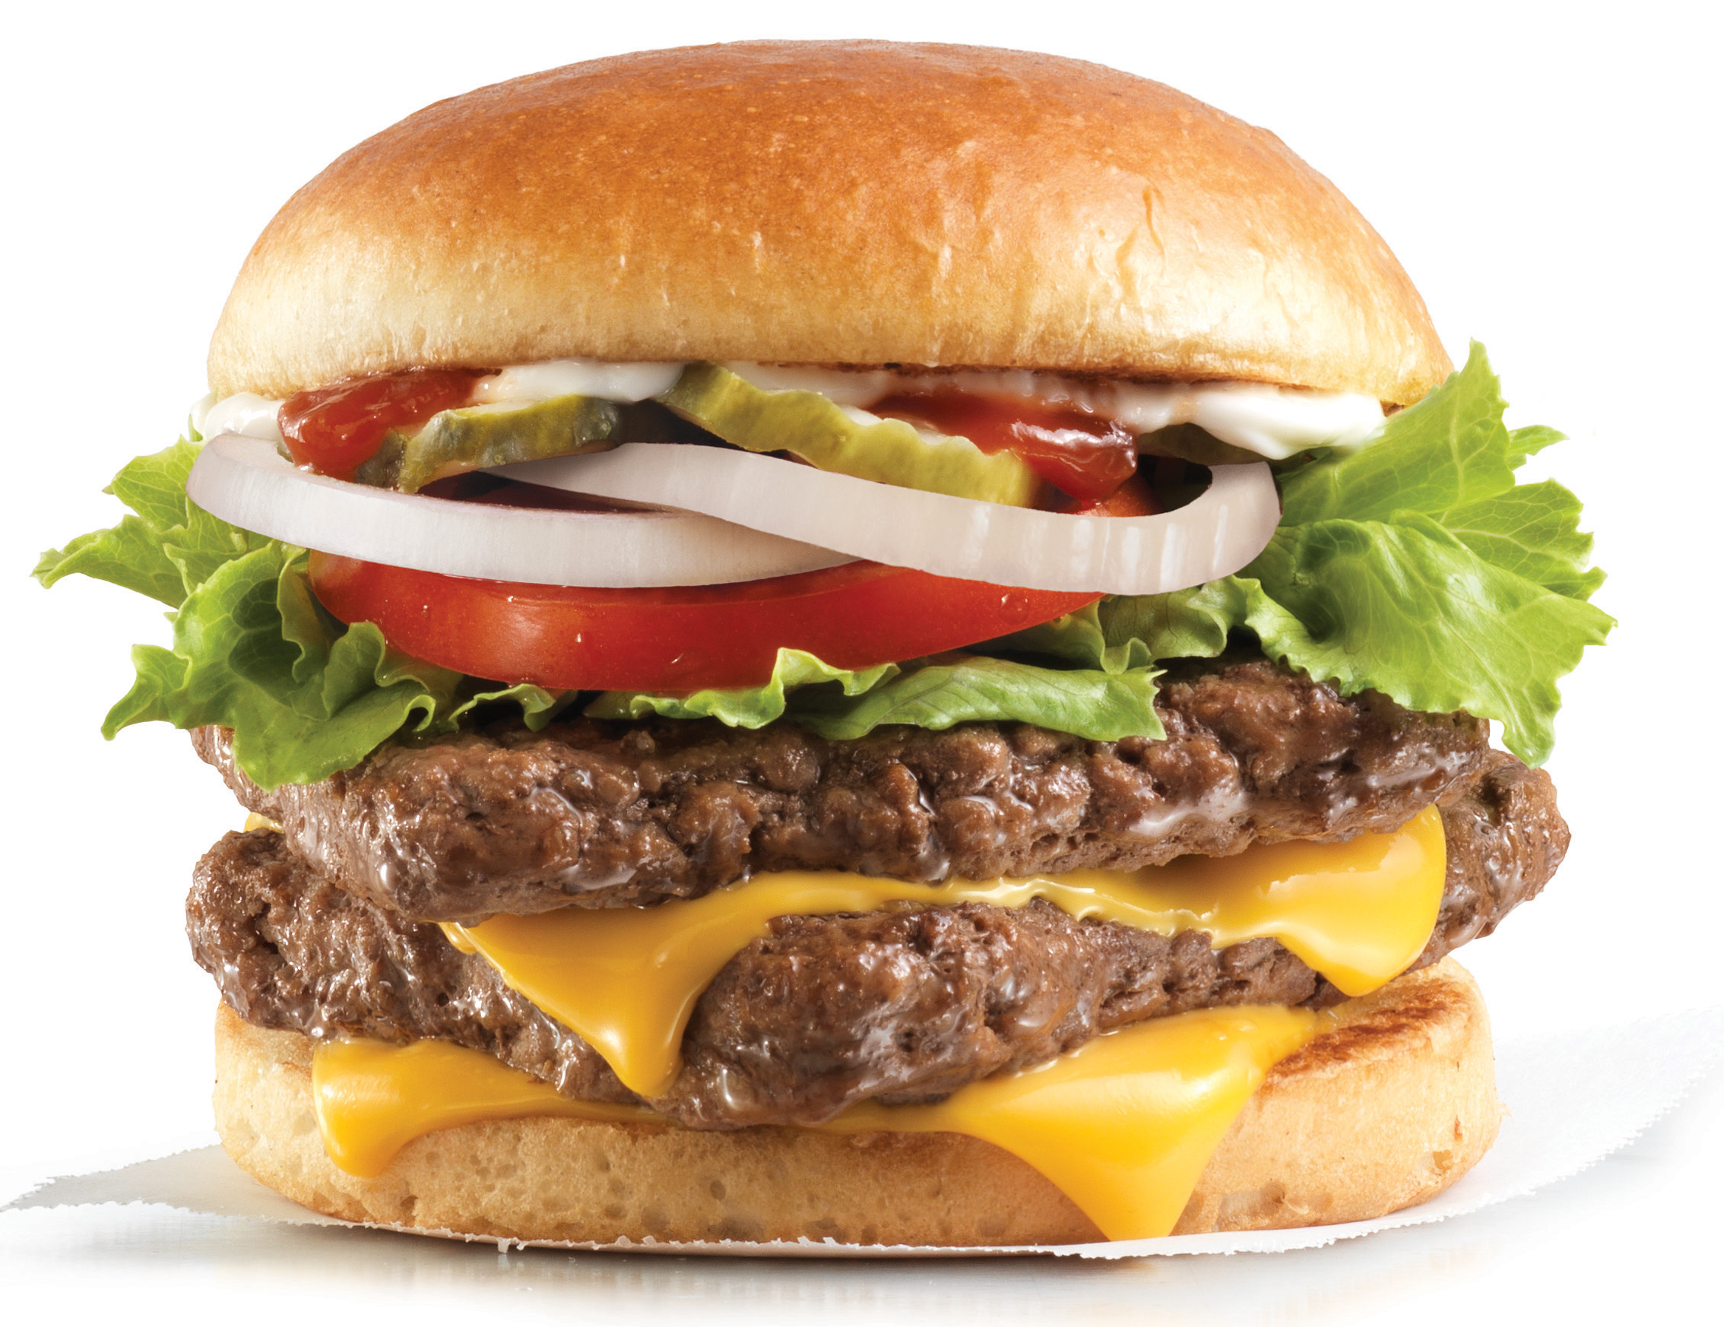
Segment 3 - Hamburgers or Bust!
General Outlook
Segment Size (29.74%)
Revenue Share (13.98%)
Mostly purchase Hamburgers
Less likely to consume during dinner
Marcom and Elasticity
Increase the communication through Direct Mail
Decrease Email to the consumers in this segment
Inelastic (0.0518)

Slide 12
Segment 3 - Hamburgers or Bust!
Suggestions
Bundle deals as :
i) Hamburger + Hamburger
ii) Fries + Chicken + Beverage
Marketing Recommendation
Send coupons for the bundles
Promotional offers for dinner time such as Specialty Hamburgers exclusively for Dinner

Slide 13
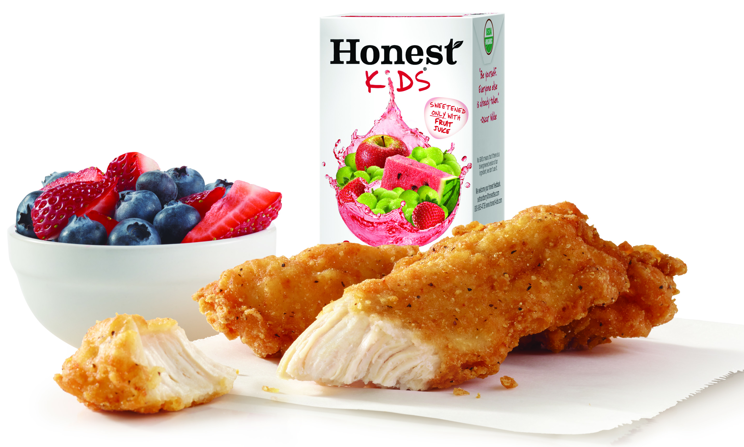
Segment 4 – Soccer Parents
General Outlook
Segment Size (10.38%)
Revenue Share (58.69%)
Most Loyal Customer Segment
Highest number of transactions
Only segment with Kid’s Meals
Lowest Household Income
Most engaged customer segment with rewards program
Marcom and Elasticity
Continue with the current marketing strategy
Inelastic (0.1865)

Slide 14
Segment 4 – Soccer Parents
Suggestions
Bundle deals as :
i) Fries + Value Meal
ii) Hamburger + Value Meal + Salad
iii) Chicken + Value Meal +Salad
iv) Value Meal + Hamburger + Chicken + Fries + Salad
Marketing Recommendations
Send more coupons for the bundles and offer different combo options
Offer goodies for kids
Increase rewards for afternoon and night spending

Slide 15
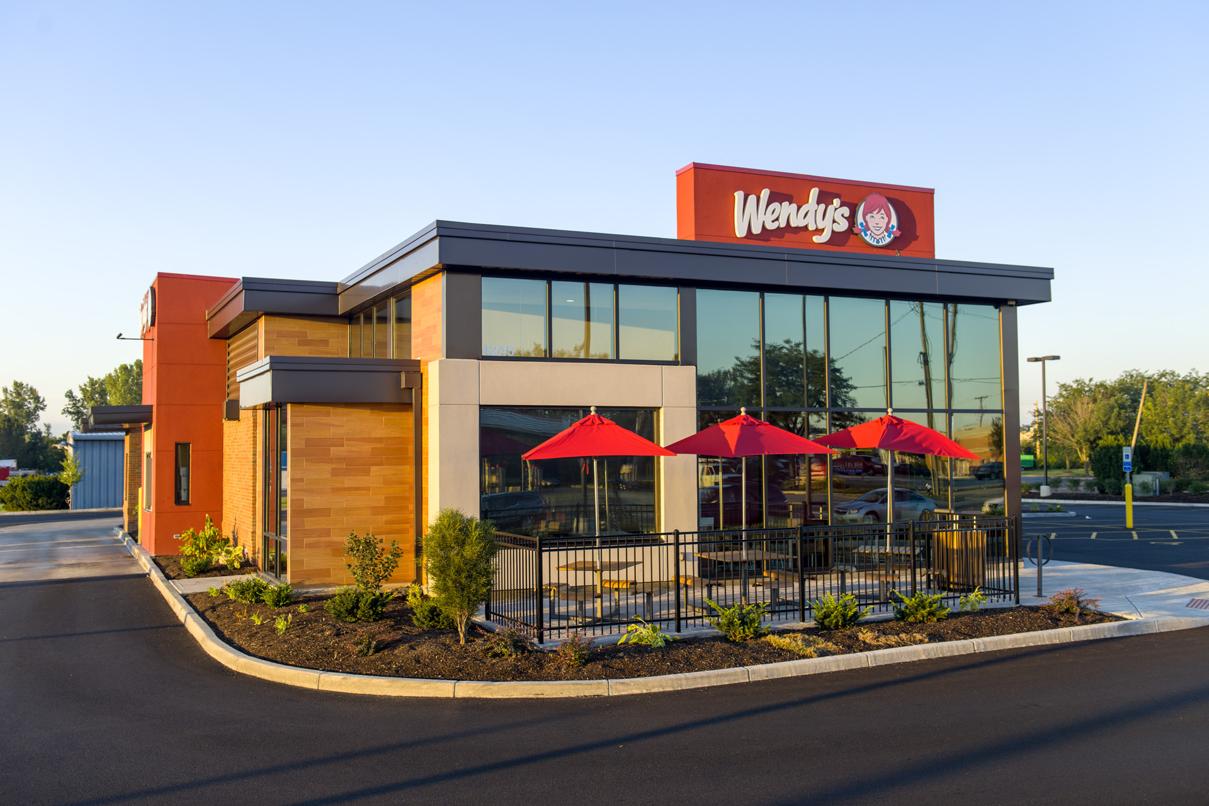
Segment Recap
Segments are inelastic.
Slight increases in price (10-15%), should not be met with a negative response from the client base and will increase total revenue by 11%.
Half of the segments are not receptive to SMS communication.
We can concentrate our marketing messaging efforts in other channels.

Slide 16
Financial Implications
 | Current Revenue | Elasticity | Price Change | New Revenue | % Increase
Frosty Fans | $ 14,307.81 | 0.0939 | 15% | $ 16,222.18 | 13%
Health Nuts | $ 14,701.72 | 0.0608 | 10% | $ 16,073.54 | 9%
Hamburgers or Bust! | $ 14,222.81 | 0.0518 | 15% | $ 16,229.06 | 14%
Soccer Parents | $ 22,162.79 | 0.1865 | 10% | $ 23,924.29 | 8%
Total | $ 65,395.13 |  |  | $ 72,449.07 | 11%
Estimated Difference (Revenue) Per Store = $ 7,053.94

Slide 17
Rewards Program Upgrades
Goals:
Reward existing loyal customers.
Encourage engagement from segments not actively participating in rewards program.
Encourage increased buying patterns in terms of quantity, frequency, and time of day to maximize potential revenue.
Method:
Competitive, game based challenges
Ex: Try three different menu items within ten days.
Craft reward challenges specifically tailored to each segments buying behaviors and ideal product bundling.
Ex: Health Nuts Segment- Earn double rewards points when you buy a chicken menu item in the evening.
Combines both a time and menu item with growth potential.
Silver – Basic, entry level. Current rewards program. Current offer = Earn a free Dave’s Single with sign up.
Gold – After 50th reward point is earned customers reach Gold Status where they can earn monthly rewards and have the option to increase reward earnings through successful completion of tasks.
Platinum – Reached after customer reaches their 250th reward point. This makes them eligible for weekly reward offers. Like the Gold level they can also increase reward points through successful completion of challenges.

Slide 18
Test & Learn Plan
1
Apply recommended strategies to Wendy's in one city for the duration of one quarter.
2
If successful, apply recommended strategies to an entire DMA.
3
Use multivariate testing to analyze impact of new marketing strategy adjustments on variables, menu item sales.
4
If successful lift in revenue is achieved after both testing phases have concluded, roll out new strategies nationwide.

Slide 19
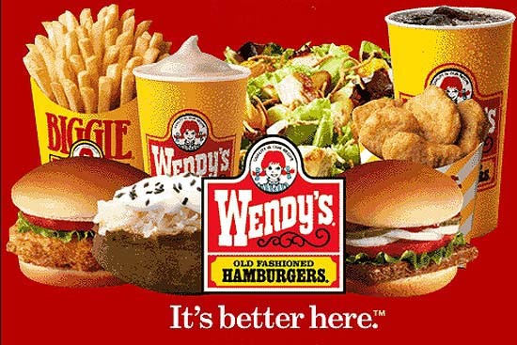

Slide 20
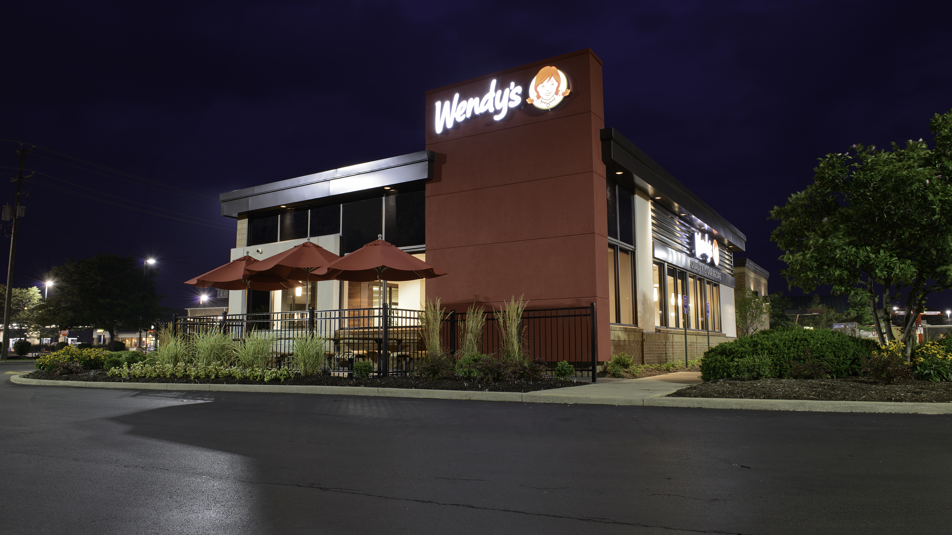
Thank You!

